Slide 1
CPR E 281: Digital Logic
Md Maruf Ahamed
Office: 307 Durham Center
Phone: (515) 294-6323
Email: maruf@iastate.edu

Slide 2
Administrative Stuff
  Homework: HW#6 due on Sunday @ 11:59 PM
  Quiz: Quiz #6 due on Friday @ 4:25 PM
  Recitation: Recitation 6 this week
  Lab: Lab 6 this week
  Lecture-20 Readings: Section 4.4 and 4.5

Slide 3
19-Decoders and Encoders
  Multiplexers
    Implementation of logic functions using Multiplexers
    Multiplexers Synthesis Using Shannon’s Expansion
  Decoder
    Design a 4-to-16 Decoder
    Design a 5-to-32 Decoder
  Demultiplexers
    Design a 1-to-4 demultiplexer
  Encoders
    Binary Encoders
    Priority Encoders

Slide 4
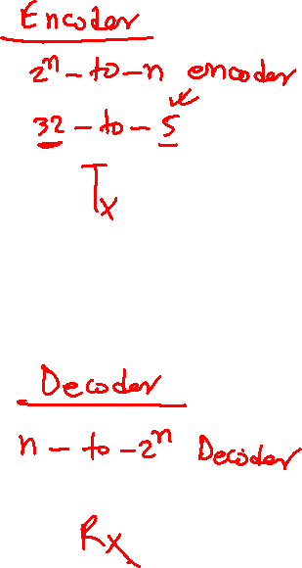
Decoders and Encoders
Readings 4.2, 4.3

Slide 5
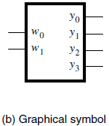
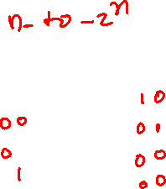
2-to-4 Decoder (Definition)
Has two inputs: w₁ and w₀
Has four outputs: y₀ , y_{1 ,} y₂ , and y₃
If w₁=0 and w₀=0, then the output y₀ is set to 1
If w₁=0 and w₀=1, then the output y₁ is set to 1
If w₁=1 and w₀=0, then the output y₂ is set to 1
If w₁=1 and w₀=1, then the output y₃ is set to 1
Only one output is set to 1. All others are set to 0.

Slide 6
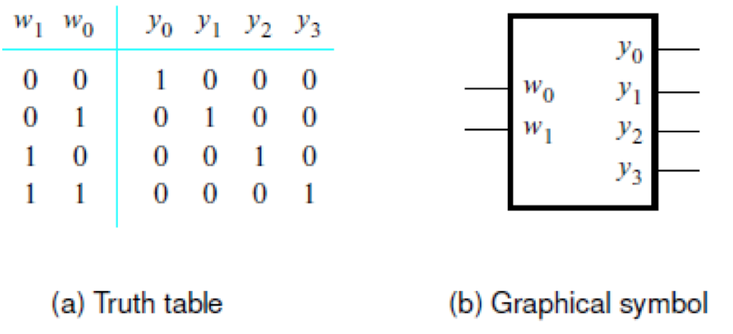

Truth Table and Graphical Symbol for a 2-to-4 Decoder
[ Figure 4.13a-b from the textbook ]

Slide 7
Truth Table and Graphical Symbol for a 2-to-4 Decoder
The outputs are “one-hot” encoded
[ Figure 4.13a-b from the textbook ]

Slide 8
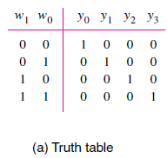
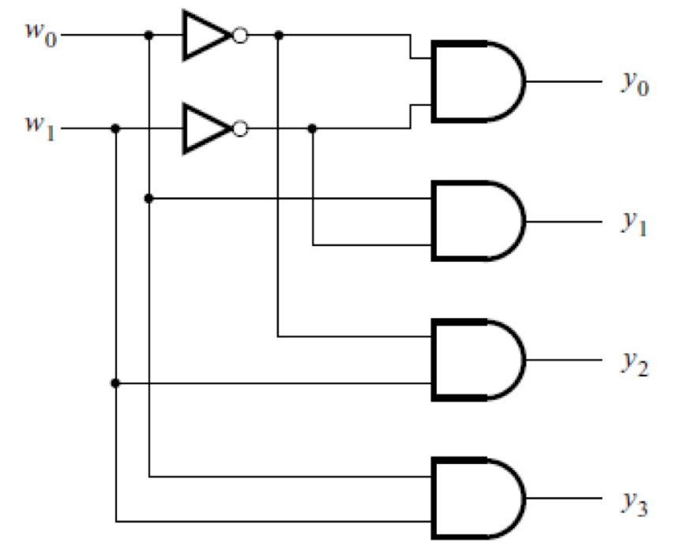
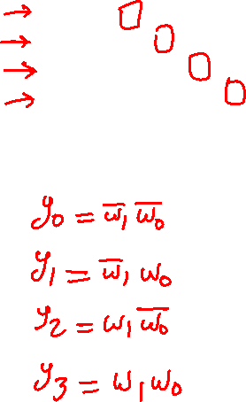
The Logic Circuit for a 2-to-4 Decoder
[ Figure 4.13c from the textbook ]

Slide 9
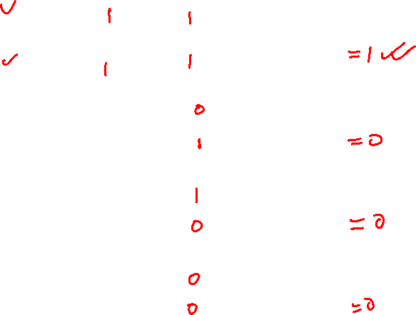
The Logic Circuit for a 2-to-4 Decoder
0
0
[ Figure 4.13c from the textbook ]

Slide 10
The Logic Circuit for a 2-to-4 Decoder
0
1
0
1
0
1
1
0
0
0
[ Figure 4.13c from the textbook ]

Slide 11
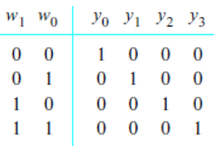
The Logic Circuit for a 2-to-4 Decoder
0
1
1
0
1
0
0
1
1
0
0
0
0
0
[ Figure 4.13c from the textbook ]

Slide 12
The Logic Circuit for a 2-to-4 Decoder
1
0
0
0
1
1
1
1
0
0
0
1
0
0
[ Figure 4.13c from the textbook ]

Slide 13
The Logic Circuit for a 2-to-4 Decoder
0
1
0
1
0
0
0
0
1
1
1
0
0
1
[ Figure 4.13c from the textbook ]

Slide 14
The Logic Circuit for a 2-to-4 Decoder
1
0
0
1
0
1
0
0
0
0
1
1
1
1
[ Figure 4.13c from the textbook ]

Slide 15
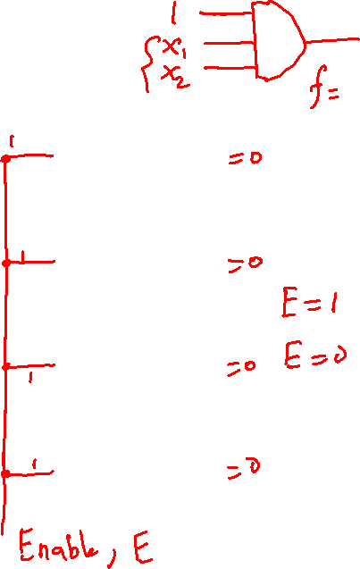
Adding an Enable Input
[ Figure 4.13c from the textbook ]

Slide 16
Adding an Enable Input
En
[ Figure 4.13c from the textbook ]

Slide 17
Adding an Enable Input
1
1
1
1
En
1
When En=1 this circuit behaves
like the one without enable.

Slide 18
Adding an Enable Input
0
0
0
0
0
0
0
0
En
0
When En=0 all outputs are set
to 0 and the decoder is disabled.

Slide 19
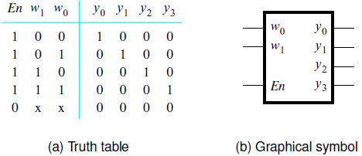
Truth Table and Graphical Symbol for a 2-to-4 Decoder with an Enable Input
[ Figure 4.14a-b from the textbook ]

Slide 20
Truth Table and Graphical Symbol for a 2-to-4 Decoder with an Enable Input
x indicates that it does not matter
what the value of this variable is
for this row of the truth table
[ Figure 4.14a-b from the textbook ]

Slide 21
Truth Table and Graphical Symbol for a 2-to-4 Decoder with an Enable Input
0 0 0 0 0 0 0
0 0 1 0 0 0 0
0 1 0 0 0 0 0
0 1 1 0 0 0 0
[ Figure 4.14a-b from the textbook ]

Slide 22
Truth Table and Graphical Symbol for a 2-to-4 Decoder with an Enable Input
0 0 0 0 0 0 0
0 0 1 0 0 0 0
0 1 0 0 0 0 0
0 1 1 0 0 0 0
1 0 0 1 0 0 0
1 0 1 0 1 0 0
1 1 0 0 0 1 0
1 1 1 0 0 0 1
[ Figure 4.14a-b from the textbook ]

Slide 23
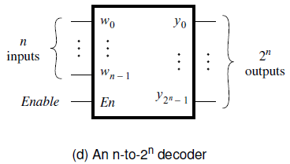
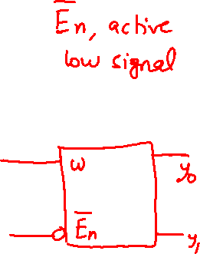
Graphical Symbol for a Binary n-to-2^{n} Decoder with an Enable Input
A binary decoder with n inputs has 2^{n} outputs
The outputs of an enabled binary decoder are “one-hot” encoded,
meaning that only a single bit is set to 1, i.e., it is hot.
[ Figure 4.14d from the textbook ]

Slide 24
How can we build larger decoders?
3-to-8 ?
4-to-16?
5-to-??

Slide 25
Hint: How did we build a 16-1 Multiplexer
s
0
s
1
w
0
w
3
w
4
s
2
s
3
w
7
f
w
8
w
11
w
12
w
15
[ Figure 4.4 from the textbook ]

Slide 26
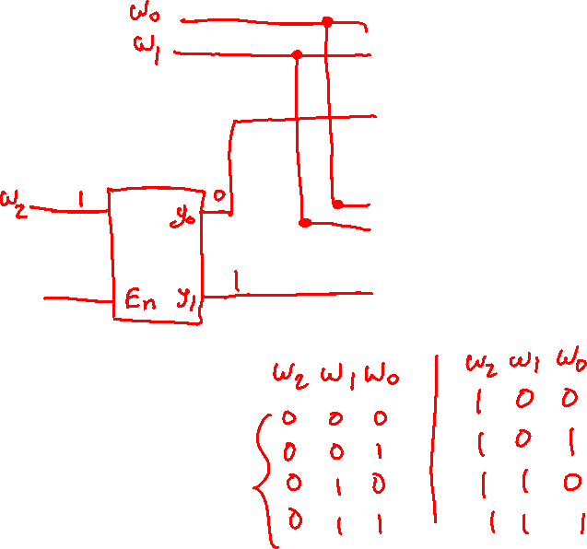
A 3-to-8 decoder using two 2-to-4 decoders
w
y
y
0
0
0
w
y
y
1
1
1
y
y
2
2
En
y
y
3
3
w
y
y
0
0
4
w
y
y
1
1
5
y
y
2
6
En
y
y
3
7
[ Figure 4.15 from the textbook ]

Slide 27
A 3-to-8 decoder using two 2-to-4 decoders
w
w
y
y
0
0
0
0
w
w
y
y
1
1
1
1
y
y
w
w₀
2
2
2
y₀
En
y
y
3
3
En
En
y₁
w
y
y
0
0
4
w
y
y
1
1
5
y
y
2
6
En
y
y
3
7
[ Figure 4.15 from the textbook ]

Slide 28

A 3-to-8 decoder using two 2-to-4 decoders
w
w
y
y
0
0
0
0
w
w
y
y
1
1
1
1
y
y
w
2
2
2
En
y
y
3
3
En
w
y
y
0
0
4
w
y
y
1
1
5
y
y
2
6
En
y
y
3
7
[ Figure 4.15 from the textbook ]

Slide 29
A 3-to-8 decoder using two 2-to-4 decoders
w
w
y
y
0
0
0
0
w
w
y
y
1
1
1
1
y
y
w
2
2
2
En
y
y
3
3
En
w
y
y
0
0
4
w
y
y
1
1
5
y
y
2
6
En
y
y
3
7
What is this?
[ Figure 4.15 from the textbook ]

Slide 30
What is this?
w
y
0
0
En
y
1
This is a 1-to-2 decoder with an enable input.

Slide 31
A 3-to-8 decoder using two 2-to-4 decoders
w
w
y
y
0
0
0
0
w
w
y
y
1
1
1
1
y
y
w
2
2
2
En
y
y
3
3
En
w
y
y
0
0
4
w
y
y
1
1
5
y
y
2
6
En
y
y
3
7
[ Figure 4.15 from the textbook ]

Slide 32
A 3-to-8 decoder using two 2-to-4 decoders
0
w
w
y
y
0
0
0
0
0
w
w
y
y
1
1
1
0
1
y
y
w
0
2
0
2
2
En
y
y
3
3
0
0
0
En
w
y
y
0
0
0
4
w
y
y
1
1
0
5
0
y
y
0
2
0
6
En
y
y
3
7
[ Figure 4.15 from the textbook ]

Slide 33
A 3-to-8 decoder using two 2-to-4 decoders
0
1
w
w
y
y
0
0
0
0
0
0
w
w
y
y
1
0
1
1
0
1
1
y
y
w
1
2
0
2
2
En
y
y
3
3
1
1
0
En
w
y
y
0
0
0
4
w
y
y
1
1
0
5
1
y
y
0
2
0
6
En
y
y
3
7
0
[ Figure 4.15 from the textbook ]

Slide 34
A 3-to-8 decoder using two 2-to-4 decoders
1
0
w
w
y
y
0
0
0
0
1
0
w
w
y
y
1
0
1
1
0
1
1
y
y
w
1
2
0
2
2
En
y
y
3
3
1
1
0
En
w
y
y
0
0
0
4
w
y
y
1
1
0
5
1
y
y
0
2
0
6
En
y
y
3
7
0
[ Figure 4.15 from the textbook ]

Slide 35
A 3-to-8 decoder using two 2-to-4 decoders
0
0
w
w
y
y
0
1
0
0
0
0
w
w
y
y
1
0
1
1
1
1
1
y
y
w
1
2
0
2
2
En
y
y
3
3
1
1
0
En
w
y
y
0
0
0
4
w
y
y
1
1
0
5
1
y
y
0
2
0
6
En
y
y
3
7
0
[ Figure 4.15 from the textbook ]

Slide 36
A 3-to-8 decoder using two 2-to-4 decoders
1
0
w
w
y
y
0
1
0
0
0
0
w
w
y
y
1
0
1
1
0
1
1
y
y
w
1
2
1
2
2
En
y
y
3
3
1
1
0
En
w
y
y
0
0
0
4
w
y
y
1
1
0
5
1
y
y
0
2
0
6
En
y
y
3
7
0
[ Figure 4.15 from the textbook ]

Slide 37
A 3-to-8 decoder using two 2-to-4 decoders
0
0
w
w
y
y
0
0
0
0
0
0
w
w
y
y
1
1
1
1
0
1
0
y
y
w
0
2
0
2
2
En
y
y
3
3
1
1
1
En
w
y
y
0
0
0
4
w
y
y
1
1
0
5
1
y
y
1
2
0
6
En
y
y
3
7
1
[ Figure 4.15 from the textbook ]

Slide 38
A 3-to-8 decoder using two 2-to-4 decoders
1
0
w
w
y
y
0
0
0
0
0
0
w
w
y
y
1
1
1
1
0
1
0
y
y
w
0
2
0
2
2
En
y
y
3
3
1
1
0
En
w
y
y
0
0
1
4
w
y
y
1
1
0
5
1
y
y
1
2
0
6
En
y
y
3
7
1
[ Figure 4.15 from the textbook ]

Slide 39
A 3-to-8 decoder using two 2-to-4 decoders
0
0
w
w
y
y
0
1
0
0
0
0
w
w
y
y
1
1
1
1
0
1
0
y
y
w
0
2
0
2
2
En
y
y
3
3
1
1
0
En
w
y
y
0
0
0
4
w
y
y
1
1
1
5
1
y
y
1
2
0
6
En
y
y
3
7
1
[ Figure 4.15 from the textbook ]

Slide 40
A 3-to-8 decoder using two 2-to-4 decoders
1
0
w
w
y
y
0
1
0
0
0
0
w
w
y
y
1
1
1
1
0
1
0
y
y
w
0
2
0
2
2
En
y
y
3
3
1
1
0
En
w
y
y
0
0
0
4
w
y
y
1
1
0
5
1
y
y
1
2
1
6
En
y
y
3
7
1
[ Figure 4.15 from the textbook ]

Slide 41
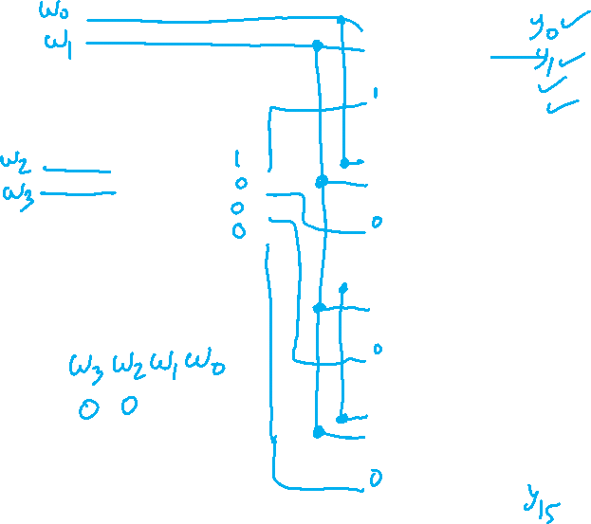
A 4-to-16 decoder built using a decoder tree
w
y
0
0
w
y
1
1
y
2
En
y
3
w
y
w
y
0
0
0
0
w
y
w
y
1
1
1
1
y
y
2
2
En
y
En
y
3
3
w
y
0
0
w
y
1
1
y
2
En
y
3
w
y
0
0
w
y
1
1
y
2
En
y
3
[ Figure 4.16 from the textbook ]

Slide 42
A 4-to-16 decoder built using a decoder tree
w
w
y
y
0
0
0
0
w
w
y
y
1
1
1
1
y
y
2
2
En
y
y
3
3
w
y
y
4
0
0
w
y
y
5
1
1
y
y
w
2
6
2
w
y
En
y
y
0
0
3
7
w
w
y
3
1
1
y
2
y
w
y
y
En
En
w
8
3
0
0
w
y
y
9
1
1
y
y
2
10
En
y
y
3
11
w
y
y
12
0
0
w
y
y
13
1
1
y
y
2
14
En
y
y
3
15
[ Figure 4.16 from the textbook ]

Slide 43
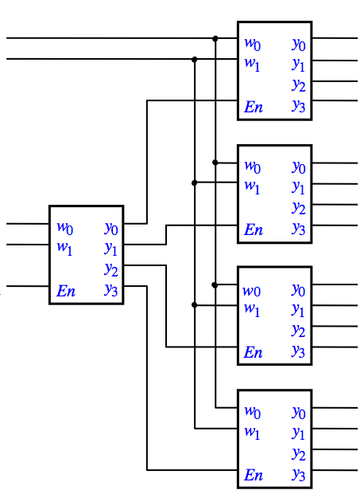
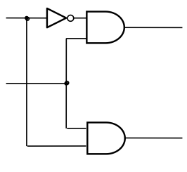
Let’s build a
5-to-32 decoder

Slide 44
Let’s build a
5-to-32 decoder
y₀ – y₁₅
En
y₁₆ – y₃₁

Slide 45
Let’s build a
5-to-32 decoder
w₀
w₁
w₂
w₃
y₀ – y₁₅
w₄
En
w₀
w₁
w₂
w₃
y₁₆ – y₃₁

Slide 46
Demultiplexers

Slide 47
Demultiplexer (Definition)
The purpose of the multiplexer circuit is to multiplex the n data inputs onto the single data output under control of the select inputs.
A circuit that performs the opposite function, namely, placing the value of a single data input onto multiple data outputs, is called a demultiplexer.

Slide 48
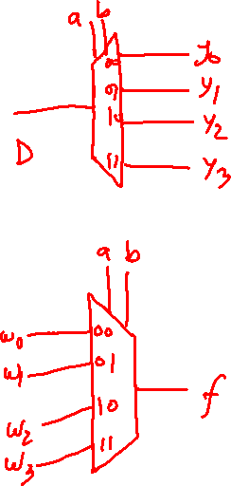
1-to-4 Demultiplexer (Definition)
Has one data input line: D
Has two output select lines: w₁ and w₀
Has four outputs: y₀ , y_{1 ,} y₂ , and y₃
If w₁=0 and w₀=0, then the output y₀ is set to D
If w₁=0 and w₀=1, then the output y₁ is set to D
If w₁=1 and w₀=0, then the output y₂ is set to D
If w₁=1 and w₀=1, then the output y₃ is set to D
Only one output is set to D. All others are set to 0.

Slide 49
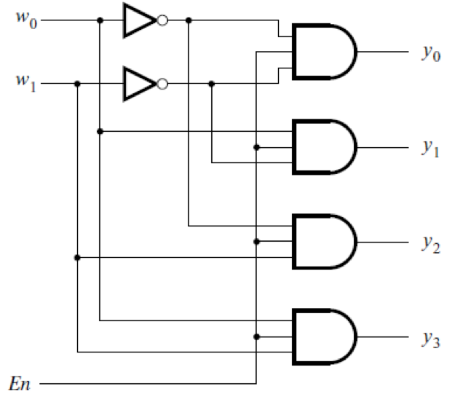
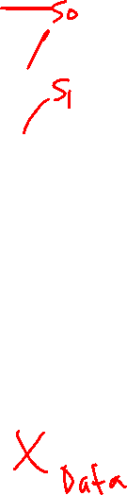
A 1-to-4 demultiplexer
built with a 2-to-4 decoder
[ Figure 4.14c from the textbook ]

Slide 50
A 1-to-4 demultiplexer
built with a 2-to-4 decoder
output
select
lines
the
four
output
lines
data
input
line
D
[ Figure 4.14c from the textbook ]

Slide 51
Demultiplexer vs Decoder
In general, an n-to-2^{n} decoder circuit can be used as a 1-to-n demultiplexer.
However, in practice decoder circuits are used much more often as decoders rather than as demultiplexers.

Slide 52
Synthesis of Logic Circuits
Using Decoders

Slide 53
Example: Implement f using one 3-to-8 decoder and a minimal number of logic gates.
w
1
w
2
w
3
f
0
0
0
0
0
0
1
0
0
1
0
0
0
1
1
1
1
0
0
0
1
0
1
1
1
1
0
1
1
1
1
1
[ Figure 4.7 from the textbook ]

Slide 54
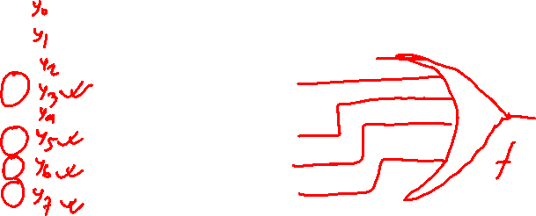
Example: Implement f using one 3-to-8 decoder and a minimal number of logic gates.
w
1
w
2
w
3
f
0
0
0
0
w
y
0
0
0
0
1
0
w
y
1
1
0
1
0
0
w
y
2
2
0
1
1
1
y
3
1
0
0
0
y
4
1
0
1
1
y
5
1
1
0
1
y
6
1
1
1
1
En
y
7
[ Figure 4.7 from the textbook ]

Slide 55
Multiplexers
(Implemented with Decoders)

Slide 56
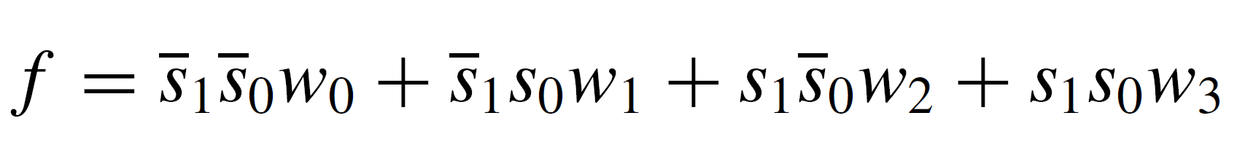
A 4-to-1 multiplexer
built using a 2-to-4 decoder
w
y
0
0
w
y
1
1
y
2
En
y
3
[ Figure 4.17 from the textbook ]

Slide 57
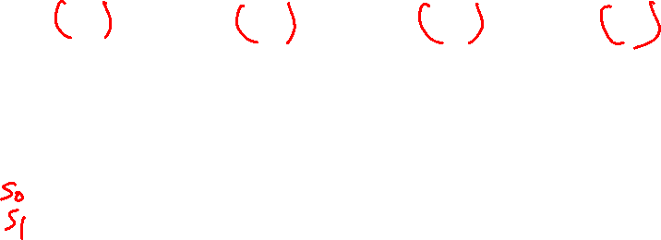
A 4-to-1 multiplexer
built using a 2-to-4 decoder
w
y
0
0
w
y
1
1
y
2
En
y
3
[ Figure 4.17 from the textbook ]

Slide 58
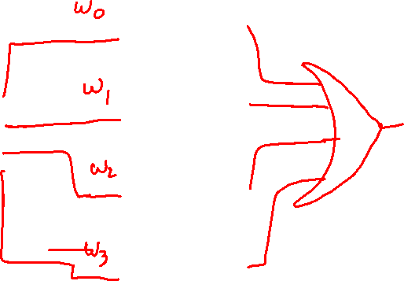
A 4-to-1 multiplexer
built using a 2-to-4 decoder
w
y
0
0
w
y
1
1
y
2
En
y
3
[ Figure 4.17 from the textbook ]

Slide 59
A 4-to-1 multiplexer
built using a 2-to-4 decoder
w
0
w
1
s
w
y
0
0
0
s
w
y
f
1
1
1
y
w
2
2
1
En
y
3
w
3
[ Figure 4.17 from the textbook ]

Slide 60
A 4-to-1 multiplexer
built using a 2-to-4 decoder
w
w₀
0
w
0
0
1
1
s
w
y
w₀
0
0
0
0
0
s
w
y
f
1
1
1
0
y
w
0
2
0
2
1
En
y
3
w
0
3
[ Figure 4.17 from the textbook ]

Slide 61
A 4-to-1 multiplexer
built using a 2-to-4 decoder
w
0
0
w₁
1
w
0
1
s
w
y
w₁
0
0
0
0
1
s
w
y
f
1
1
1
0
y
w
0
2
0
2
1
En
y
3
w
0
3
[ Figure 4.17 from the textbook ]

Slide 62
A 4-to-1 multiplexer
built using a 2-to-4 decoder
w
0
0
w
0
0
0
1
s
w
y
w₂
0
1
0
0
0
s
w
y
f
1
1
1
1
y
w
w₂
2
0
2
1
En
y
3
w
0
3
[ Figure 4.17 from the textbook ]

Slide 63
A 4-to-1 multiplexer
built using a 2-to-4 decoder
w
0
0
w
0
1
0
1
s
w
y
w₃
0
1
0
0
0
s
w
y
f
1
1
1
0
y
w
0
2
1
2
1
En
y
3
w
w₃
3
[ Figure 4.17 from the textbook ]

Slide 64
Encoders

Slide 65
Encoders (there are several types)
An encoder performs the opposite function of a decoder. It encodes given information into a more compact form.
Encoders are used to reduce the number of bits needed to represent given information.
A practical use of encoders is for transmitting information in a digital system.
Encoding the information allows the transmission link to be built using fewer wires.
Encoding is also useful if information is to be stored for later use because fewer bits need to be stored.

Slide 66
Binary Encoders

Slide 67
The Most General Case:
2^{n}-to-n binary encoder
w
0
y
0
2
n
n
inputs
outputs
y
n
–
1
w
2
n
–
1
[ Figure 4.18 from the textbook ]

Slide 68
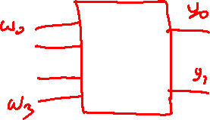
4-to-2 Binary Encoder (Definition)
Has four inputs: w₃ , w₂ , w₁ , and w₀
Has two outputs: y₁ and y₀
Only one input is set to 1 (“one-hot” encoded). All others are set to 0.
If w₀=1 then y₁=0 and y₀=0
If w₁=1 then y₁=0 and y₀=1
If w₂=1 then y₁=1 and y₀=0
If w₃=1 then y₁=1 and y₀=1

Slide 69
Truth table for a 4-to-2 binary encoder
w
w
w
w
y
y
3
2
1
0
1
0
0
0
0
1
0
0
0
0
1
0
0
1
0
1
0
0
1
0
1
0
0
0
1
1
[ Figure 4.19 from the textbook ]

Slide 70
Truth table for a 4-to-2 binary encoder
w
w
w
w
y
y
3
2
1
0
1
0
0
0
0
1
0
0
0
0
1
0
0
1
0
1
0
0
1
0
1
0
0
0
1
1
The inputs are “one-hot” encoded
[ Figure 4.19 from the textbook ]

Slide 71

Expressions for 4-to-2 binary encoder
w₃ | w₂ | w₁ | w₀ | y₁ | y₀
0 | 0 | 0 | 0
0 | 0 | 0 | 1 | 0 | 0
0 | 0 | 1 | 0 | 0 | 1
0 | 0 | 1 | 1
0 | 1 | 0 | 0 | 1 | 0
0 | 1 | 0 | 1
0 | 1 | 1 | 0
0 | 1 | 1 | 1
1 | 0 | 0 | 0 | 1 | 1
1 | 0 | 0 | 1
1 | 0 | 1 | 0
1 | 0 | 1 | 1
1 | 1 | 0 | 0
1 | 1 | 0 | 1
1 | 1 | 1 | 0
1 | 1 | 1 | 1
w
w
w
w
y
y
3
2
1
0
1
0
0
0
0
1
0
0
0
0
1
0
0
1
0
1
0
0
1
0
1
0
0
0
1
1

Slide 72
Expressions for 4-to-2 binary encoder
w₃ | w₂ | w₁ | w₀ | y₁ | y₀
0 | 0 | 0 | 0 | d | d
0 | 0 | 0 | 1 | 0 | 0
0 | 0 | 1 | 0 | 0 | 1
0 | 0 | 1 | 1 | d | d
0 | 1 | 0 | 0 | 1 | 0
0 | 1 | 0 | 1 | d | d
0 | 1 | 1 | 0 | d | d
0 | 1 | 1 | 1 | d | d
1 | 0 | 0 | 0 | 1 | 1
1 | 0 | 0 | 1 | d | d
1 | 0 | 1 | 0 | d | d
1 | 0 | 1 | 1 | d | d
1 | 1 | 0 | 0 | d | d
1 | 1 | 0 | 1 | d | d
1 | 1 | 1 | 0 | d | d
1 | 1 | 1 | 1 | d | d
w
w
w
w
y
y
3
2
1
0
1
0
0
0
0
1
0
0
0
0
1
0
0
1
0
1
0
0
1
0
1
0
0
0
1
1

Slide 73
Expressions for 4-to-2 binary encoder
w₃ | w₂ | w₁ | w₀ | y₁ | y₀
0 | 0 | 0 | 0 | d | d
0 | 0 | 0 | 1 | 0 | 0
0 | 0 | 1 | 0 | 0 | 1
0 | 0 | 1 | 1 | d | d
0 | 1 | 0 | 0 | 1 | 0
0 | 1 | 0 | 1 | d | d
0 | 1 | 1 | 0 | d | d
0 | 1 | 1 | 1 | d | d
1 | 0 | 0 | 0 | 1 | 1
1 | 0 | 0 | 1 | d | d
1 | 0 | 1 | 0 | d | d
1 | 0 | 1 | 1 | d | d
1 | 1 | 0 | 0 | d | d
1 | 1 | 0 | 1 | d | d
1 | 1 | 1 | 0 | d | d
1 | 1 | 1 | 1 | d | d
w₃ w₂
w₁ w₀
00
01
11
10
00
d
0
d
1
01
0
d
d
d
11
d
d
d
d
10
1
d
d
d
y₀ = (w₁ + w₃)
w
0
w
1
y
0
w
2
y
w
1
3

Slide 74

Expressions for 4-to-2 binary encoder
w₃ | w₂ | w₁ | w₀ | y₁ | y₀
0 | 0 | 0 | 0 | d | d
0 | 0 | 0 | 1 | 0 | 0
0 | 0 | 1 | 0 | 0 | 1
0 | 0 | 1 | 1 | d | d
0 | 1 | 0 | 0 | 1 | 0
0 | 1 | 0 | 1 | d | d
0 | 1 | 1 | 0 | d | d
0 | 1 | 1 | 1 | d | d
1 | 0 | 0 | 0 | 1 | 1
1 | 0 | 0 | 1 | d | d
1 | 0 | 1 | 0 | d | d
1 | 0 | 1 | 1 | d | d
1 | 1 | 0 | 0 | d | d
1 | 1 | 0 | 1 | d | d
1 | 1 | 1 | 0 | d | d
1 | 1 | 1 | 1 | d | d
w₃ w₂
w₁ w₀
00
01
11
10
00
d
1
d
1
01
0
d
d
d
11
d
d
d
d
10
0
d
d
d
y₁ = (w₃ + w₂)
w
0
w
1
y
0
w
2
y
w
1
3

Slide 75
Circuit for a 4-to-2 binary encoder
w
w
w
w
y
y
3
2
1
0
1
0
0
0
0
1
0
0
0
0
1
0
0
1
0
1
0
0
1
0
1
0
0
0
1
1
It is assumed that the
inputs are one hot encoded
w
0
w
1
y
0
w
2
y
w
1
3
[ Figure 4.19 from the textbook ]

Slide 76
Circuit for a 4-to-2 binary encoder
w
w
w
w
y
y
3
2
1
0
1
0
0
0
0
1
0
0
0
0
1
0
0
1
0
1
0
0
1
0
1
0
0
0
1
1
1
w
0
0
0
w
1
y
0
0
w
2
0
0
y
w
1
3
[ Figure 4.19 from the textbook ]

Slide 77
Circuit for a 4-to-2 binary encoder
w
w
w
w
y
y
3
2
1
0
1
0
0
0
0
1
0
0
0
0
1
0
0
1
0
1
0
0
1
0
1
0
0
0
1
1
As this level of abstraction we
need that w₀ input for this to be
a proper 4-to-2 binary encoder.
1
w
0
0
0
w
1
y
0
0
w
2
0
0
y
w
1
3
[ Figure 4.19 from the textbook ]

Slide 78
Circuit for a 4-to-2 binary encoder
w
w
w
w
y
y
3
2
1
0
1
0
0
0
0
1
0
0
0
0
1
0
0
1
0
1
0
0
1
0
1
0
0
0
1
1
1
w
0
0
0
w
1
y
0
0
w
2
0
0
y
w
1
3
[ Figure 4.19 from the textbook ]

Slide 79
Circuit for a 4-to-2 binary encoder
w
w
w
w
y
y
3
2
1
0
1
0
0
0
0
1
0
0
0
0
1
0
0
1
0
1
0
0
1
0
1
0
0
0
1
1
0
w
0
1
1
w
1
y
0
0
w
2
0
0
y
w
1
3
[ Figure 4.19 from the textbook ]

Slide 80
Circuit for a 4-to-2 binary encoder
w
w
w
w
y
y
3
2
1
0
1
0
0
0
0
1
0
0
0
0
1
0
0
1
0
1
0
0
1
0
1
0
0
0
1
1
0
w
0
0
0
w
1
y
1
0
w
2
1
0
y
w
1
3
[ Figure 4.19 from the textbook ]

Slide 81
Circuit for a 4-to-2 binary encoder
w
w
w
w
y
y
3
2
1
0
1
0
0
0
0
1
0
0
0
0
1
0
0
1
0
1
0
0
1
0
1
0
0
0
1
1
0
w
0
0
1
w
1
y
0
0
w
2
1
1
y
w
1
3
[ Figure 4.19 from the textbook ]

Slide 82
Priority Encoders

Slide 83
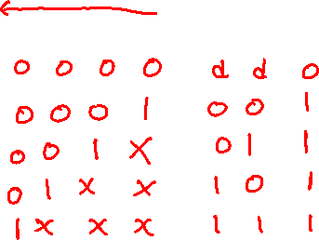
Truth table for a 4-to-2 priority encoder
w
w
w
w
y
y
z
3
2
1
0
1
0
0
0
0
0
d
d
0
0
0
0
1
0
0
1
0
0
1
x
0
1
1
0
1
x
x
1
0
1
1
x
x
x
1
1
1
In a priority encoder each input has a priority level associated with it. The encoder outputs indicate the active input that has the highest priority.
When an input with a high priority is asserted, the other inputs with lower priority are ignored.
It assumes that w₀ has the lowest priority and w₃ the highest.
Since it is possible that none of the inputs is equal to 1, an output, z, is provided to indicate this condition.
[ Figure 4.20 from the textbook ]

Slide 84
Truth table for a 4-to-2 priority encoder
w
w
w
w
y
y
z
3
2
1
0
1
0
0
0
0
0
d
d
0
0
0
0
1
0
0
1
0
0
1
x
0
1
1
0
1
x
x
1
0
1
1
x
x
x
1
1
1
In a priority encoder each input has a priority level associated with it. The encoder outputs indicate the active input that has the highest priority.
When an input with a high priority is asserted, the other inputs with lower priority are ignored.
It assumes that w₀ has the lowest priority and w₃ the highest.
Since it is possible that none of the inputs is equal to 1, an output, z, is provided to indicate this condition.
[ Figure 4.20 from the textbook ]

Slide 85
Truth table for a 4-to-2 priority encoder
(abbreviated version)
w
w
w
w
y
y
z
3
2
1
0
1
0
0
0
0
0
d
d
0
0
0
0
1
0
0
1
0
0
1
x
0
1
1
0
1
x
x
1
0
1
1
x
x
x
1
1
1
[ Figure 4.20 from the textbook ]

Slide 86

Truth table for a 4-to-2 priority encoder
w₃ | w₂ | w₁ | w₀ | y₁ | y₀ | z
0 | 0 | 0 | 0 | d | d | 0
0 | 0 | 0 | 1 | 0 | 0 | 1
0 | 0 | 1 | 0 | 0 | 1 | 1
0 | 0 | 1 | 1 | 0 | 1 | 1
0 | 1 | 0 | 0 | 1 | 0 | 1
0 | 1 | 0 | 1 | 1 | 0 | 1
0 | 1 | 1 | 0 | 1 | 0 | 1
0 | 1 | 1 | 1 | 1 | 0 | 1
1 | 0 | 0 | 0 | 1 | 1 | 1
1 | 0 | 0 | 1 | 1 | 1 | 1
1 | 0 | 1 | 0 | 1 | 1 | 1
1 | 0 | 1 | 1 | 1 | 1 | 1
1 | 1 | 0 | 0 | 1 | 1 | 1
1 | 1 | 0 | 1 | 1 | 1 | 1
1 | 1 | 1 | 0 | 1 | 1 | 1
1 | 1 | 1 | 1 | 1 | 1 | 1
0 0 0 0
0 0 0 1
0 0 1 x
0 1 x x
1 x x x

Slide 87
Expressions for 4-to-2 priority encoder
w₃ | w₂ | w₁ | w₀ | y₁ | y₀ | z
0 | 0 | 0 | 0 | d | d | 0
0 | 0 | 0 | 1 | 0 | 0 | 1
0 | 0 | 1 | 0 | 0 | 1 | 1
0 | 0 | 1 | 1 | 0 | 1 | 1
0 | 1 | 0 | 0 | 1 | 0 | 1
0 | 1 | 0 | 1 | 1 | 0 | 1
0 | 1 | 1 | 0 | 1 | 0 | 1
0 | 1 | 1 | 1 | 1 | 0 | 1
1 | 0 | 0 | 0 | 1 | 1 | 1
1 | 0 | 0 | 1 | 1 | 1 | 1
1 | 0 | 1 | 0 | 1 | 1 | 1
1 | 0 | 1 | 1 | 1 | 1 | 1
1 | 1 | 0 | 0 | 1 | 1 | 1
1 | 1 | 0 | 1 | 1 | 1 | 1
1 | 1 | 1 | 0 | 1 | 1 | 1
1 | 1 | 1 | 1 | 1 | 1 | 1
w₃ w₂
w₁ w₀
00
01
11
10
00
d
1
1
1
01
0
1
1
1
11
0
1
1
1
10
0
1
1
1
y₁ = w₃ + w₂

Slide 88
Expressions for 4-to-2 priority encoder
w₃ | w₂ | w₁ | w₀ | y₁ | y₀ | z
0 | 0 | 0 | 0 | d | d | 0
0 | 0 | 0 | 1 | 0 | 0 | 1
0 | 0 | 1 | 0 | 0 | 1 | 1
0 | 0 | 1 | 1 | 0 | 1 | 1
0 | 1 | 0 | 0 | 1 | 0 | 1
0 | 1 | 0 | 1 | 1 | 0 | 1
0 | 1 | 1 | 0 | 1 | 0 | 1
0 | 1 | 1 | 1 | 1 | 0 | 1
1 | 0 | 0 | 0 | 1 | 1 | 1
1 | 0 | 0 | 1 | 1 | 1 | 1
1 | 0 | 1 | 0 | 1 | 1 | 1
1 | 0 | 1 | 1 | 1 | 1 | 1
1 | 1 | 0 | 0 | 1 | 1 | 1
1 | 1 | 0 | 1 | 1 | 1 | 1
1 | 1 | 1 | 0 | 1 | 1 | 1
1 | 1 | 1 | 1 | 1 | 1 | 1
w₃ w₂
w₁ w₀
00
01
11
10
00
d
0
1
1
01
0
0
1
1
11
1
0
1
1
10
1
0
1
1
y₀ = w₃ + w₁ w₂

Slide 89
Expressions for 4-to-2 priority encoder
w₃ | w₂ | w₁ | w₀ | y₁ | y₀ | z
0 | 0 | 0 | 0 | d | d | 0
0 | 0 | 0 | 1 | 0 | 0 | 1
0 | 0 | 1 | 0 | 0 | 1 | 1
0 | 0 | 1 | 1 | 0 | 1 | 1
0 | 1 | 0 | 0 | 1 | 0 | 1
0 | 1 | 0 | 1 | 1 | 0 | 1
0 | 1 | 1 | 0 | 1 | 0 | 1
0 | 1 | 1 | 1 | 1 | 0 | 1
1 | 0 | 0 | 0 | 1 | 1 | 1
1 | 0 | 0 | 1 | 1 | 1 | 1
1 | 0 | 1 | 0 | 1 | 1 | 1
1 | 0 | 1 | 1 | 1 | 1 | 1
1 | 1 | 0 | 0 | 1 | 1 | 1
1 | 1 | 0 | 1 | 1 | 1 | 1
1 | 1 | 1 | 0 | 1 | 1 | 1
1 | 1 | 1 | 1 | 1 | 1 | 1
w₃ w₂
w₁ w₀
00
01
11
10
00
0
1
1
1
01
1
1
1
1
11
1
1
1
1
10
1
1
1
1
z = w₃ + w₂ + w₁ + w₀

Slide 90
Circuit for the 4-to-2 priority encoder
w₃ w₂ w₁ w₀
y₀
y₁
z

Slide 91
The textbook derives a different circuit for the
4-to-2 priority encoder using a 4-to-2 binary encoder
w
w
w
w
y
y
z
3
2
1
0
1
0
0
0
0
0
d
d
0
0
0
0
1
0
0
1
0
0
1
x
0
1
1
0
1
x
x
1
0
1
1
x
x
x
1
1
1

Slide 92
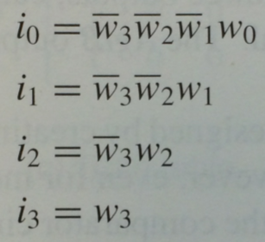
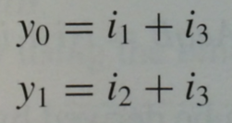

The textbook derives a different circuit for the
4-to-2 priority encoder using a 4-to-2 binary encoder
w
w
w
w
y
y
z
3
2
1
0
1
0
0
0
0
0
d
d
0
0
0
0
1
0
0
1
0
0
1
x
0
1
1
0
1
x
x
1
0
1
1
x
x
x
1
1
1

Slide 93
The textbook derives a different circuit for the
4-to-2 priority encoder using a 4-to-2 binary encoder
w
w
w
w
y
y
z
3
2
1
0
1
0
0
0
0
0
d
d
0
0
0
0
1
0
0
1
0
0
1
x
0
1
1
0
1
x
x
1
0
1
1
x
x
x
1
1
1
w
0
w
1
y
0
w
2
y
w
1
3

Slide 94
The textbook derives a different circuit for the
4-to-2 priority encoder using a 4-to-2 binary encoder
w
w
w
w
y
y
z
3
2
1
0
1
0
0
0
0
0
d
d
0
0
0
0
1
0
0
1
0
0
1
x
0
1
1
0
1
x
x
1
0
1
1
x
x
x
1
1
1
i₀
i₁
i₂
i₃
w
0
w
1
y
0
w
2
y
w
1
3
i₀ + i₁ + i₂ + i₃
z

Slide 95
The textbook derives a different circuit for the
4-to-2 priority encoder using a 4-to-2 binary encoder
w
w
w
w
y
y
z
3
2
1
0
1
0
0
0
0
0
d
d
0
0
0
0
1
0
0
1
0
0
1
x
0
1
1
0
1
x
x
1
0
1
1
x
x
x
1
1
1
i₀
i₁
i₂
i₃
w
0
w
1
y
0
w
2
y
w
1
3
i₀ + i₁ + i₂ + i₃
z
Try to prove that this is equivalent to the circuit that was derived above.

Slide 96

END Slide

